Slide 1

Precision Forecasting for Energy Demand
This presentation outlines our progress in developing a robust short-term forecasting system for hourly heat and cold demand in La Défense.
Our goal is to enable optimized operational decisions, from production dispatch to equipment start/stop timings, leveraging weather-driven ML models.
Lucie L. Mathéo I. Léo L.

Slide 2
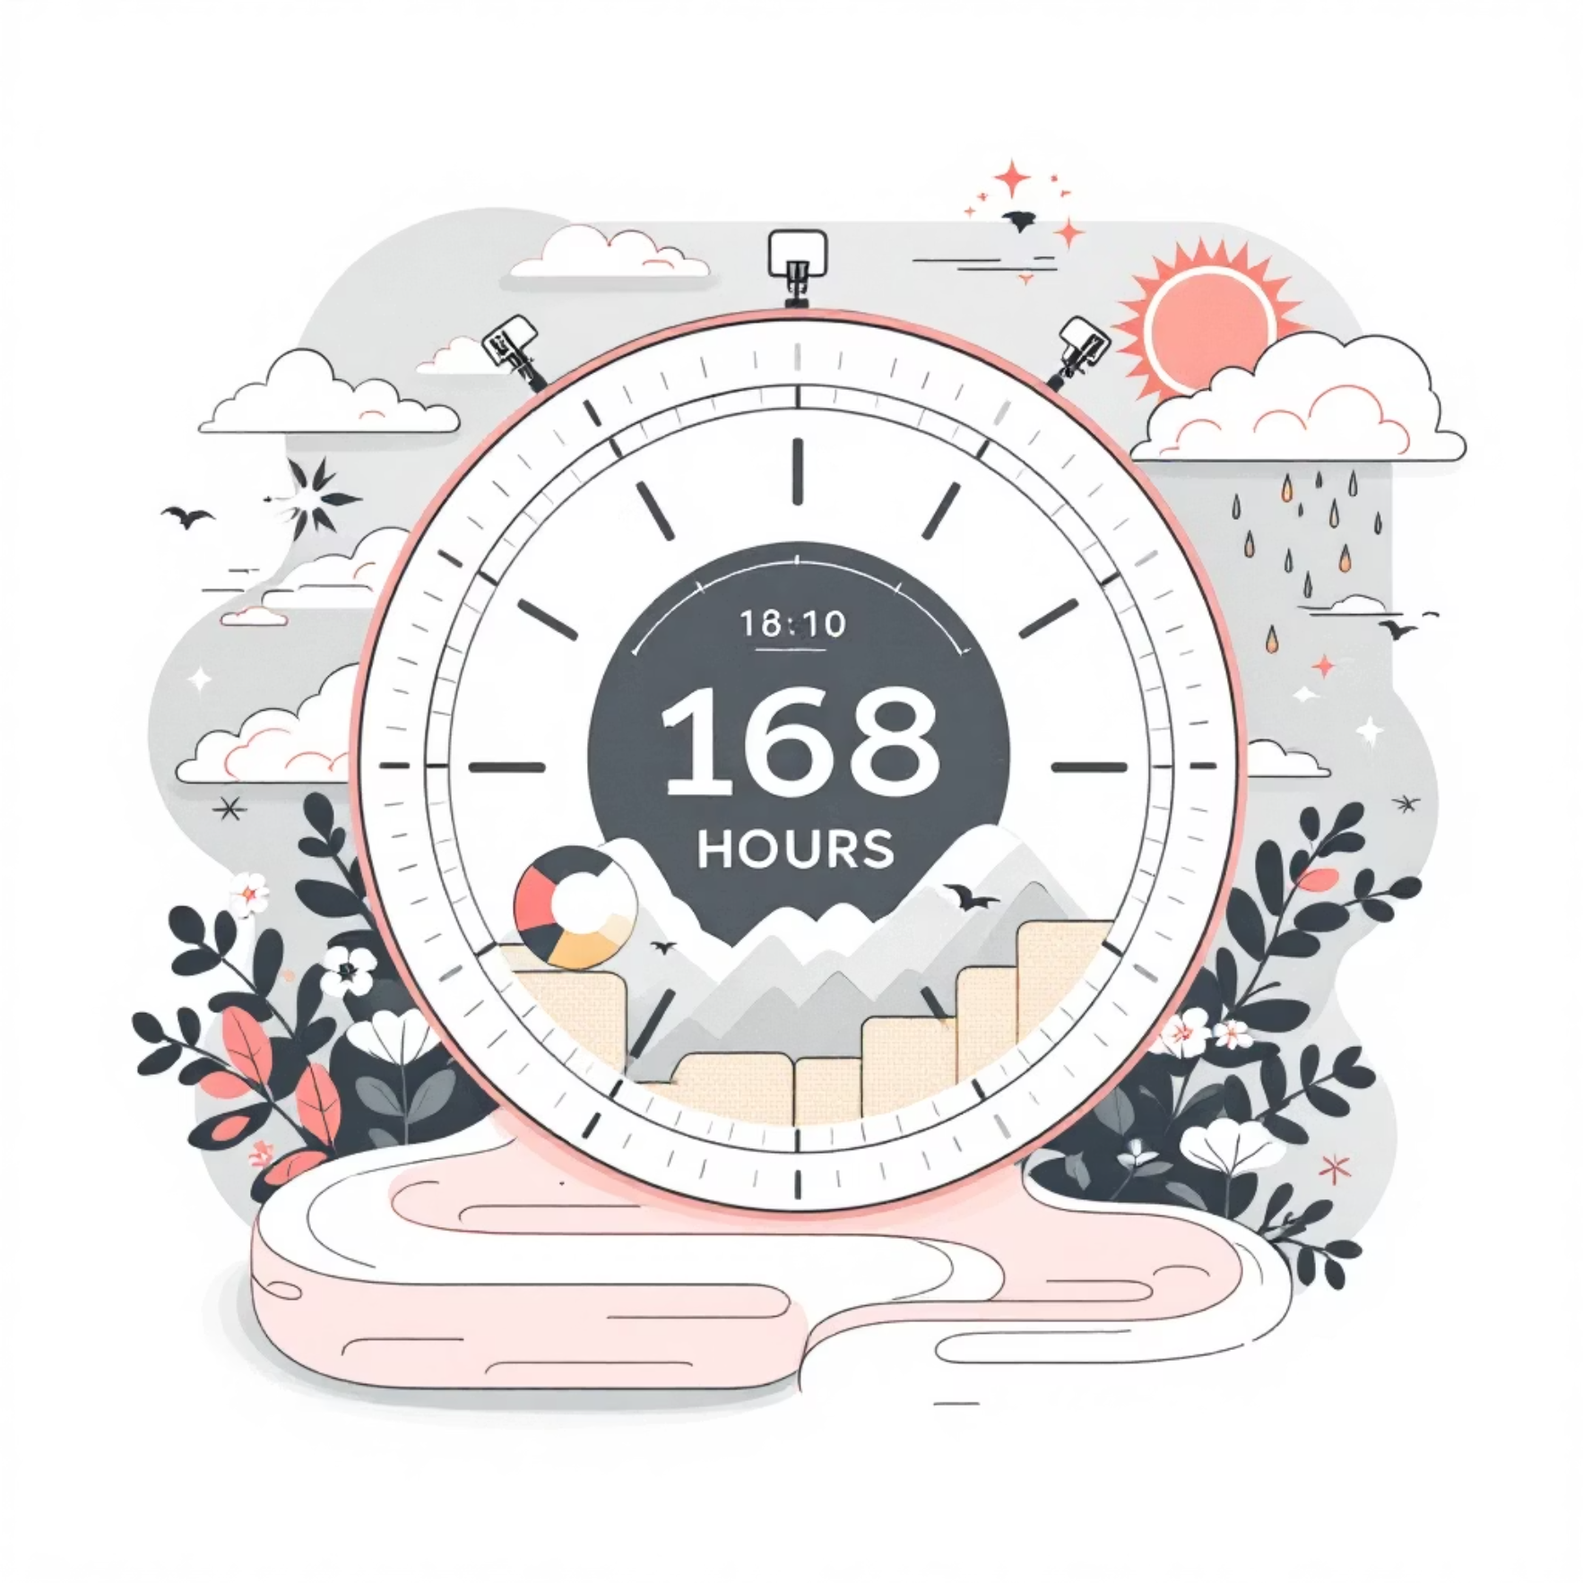
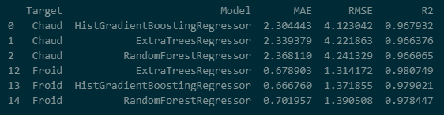
Building the Foundation: Data & Scope
Forecasting Goal & Horizon
Key Performance Indicators (KPIs)
Our primary objective is to forecast hourly heat and cold demand for La Défense with a 1-week (168-hour) horizon, utilizing external weather forecasts. This enables critical short-term operational optimization for production dispatch and start/stop decisions.
Model performance is rigorously evaluated using:
Mean Absolute Error (MAE)
Root Mean Squared Error (RMSE)
R² (Coefficient of Determination)
These are assessed on a last-year hold-out set, with specific attention to error by hour-of-day for operational relevance.
Lucie L. Mathéo I. Léo L.

Slide 3





Robust Data Pipeline for Accurate Insights
Our data pipeline is designed for precision, integrating diverse data sources and ensuring data quality.
Data Sources
Indexing & Timezone
Data Cleaning
We integrate power series (P_Chaud, P_Froid) with external weather data (T_Ext, Hum_Ext, Ensoleillement, V_Vent) and 168-hour meteo_pred weather forecasts (Open-Meteo API).
All data is indexed to hourly UTC. Strict left-join by timestamp ensures accurate alignment for all inputs.
Short gaps are interpolated time-wise. Initial rows are dropped where lags/rolls are undefined to maintain data integrity.
Feature Engineering
Data Split
Features are separated for heat and cold, including Calendar (Hour, DOW, Weekend, Month), Autoregressive (lag1, lag2, roll2h, roll4h for inertia), and Weather variables.
The last year of data serves as the test set, with the remainder used for training, allowing for robust validation.
Lucie L. Mathéo I. Léo L.

Slide 4
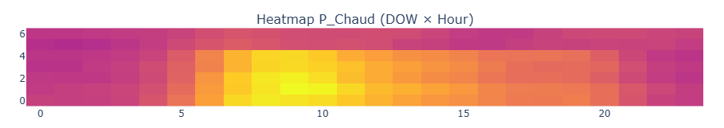
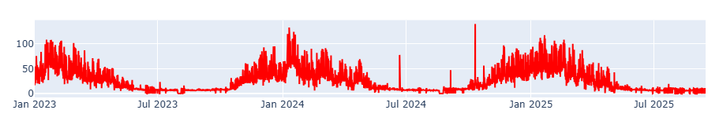
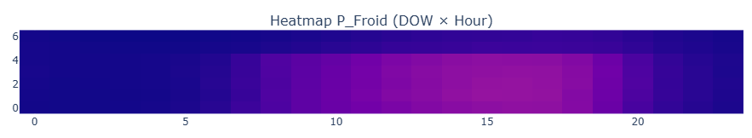
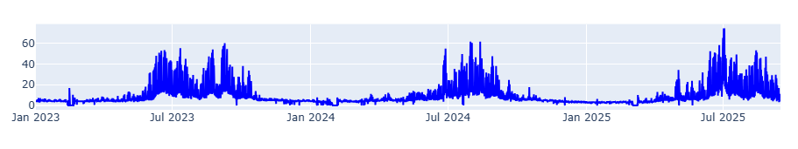
Key Insights from Exploratory Data Analysis
Daily Demand Profiles
Strong Physics & Seasonality
Heat demand consistently peaks between 08:00 and 10:00, aligning with morning startup. Cold demand reaches its zenith later in the day, from 16:00 to 18:00.
A clear inverse relationship exists between heat demand and external temperature, while cold demand directly correlates with rising temperatures. Distinct winter/summer regimes are observed.
These physical relationships are crucial for understanding and modeling demand patterns, with baselines from lags/rolls providing sensible references for model comparison.
Lucie L. Mathéo I. Léo L.

Slide 5
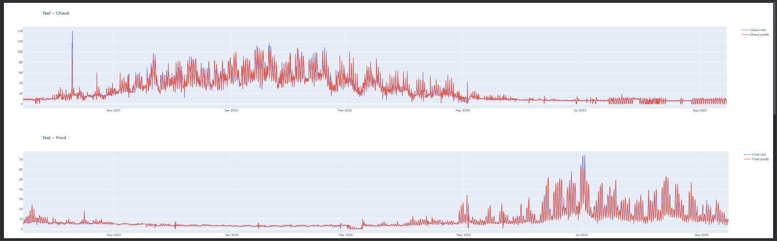
Achieved Accuracy: Models & Performance
We benchmarked various models, identifying HistGradientBoosting and ExtraTrees as top performers for both heat and cold demand forecasting.
Top Untuned Model Performance
Impact of Light Tuning
Heat (HistGradientBoosting): MAE ≈ 2.30 MW, RMSE ≈ 4.12 MW, R² ≈ 0.968
Heat Tuned: MAE 2.24, RMSE 4.06, R² 0.969
Cold (ExtraTrees / HGB): MAE ≈ 0.67 MW, RMSE ≈ 1.31–1.39 MW, R² ≈ 0.978
Cold Tuned: MAE 0.64, RMSE 1.29, R² 0.982
Light tuning, applied via time-series cross-validation, further improved model margins. The 1-week forecasts are generated by expanding known demand with lags/rolls and injecting forecast weather, with dual-axis plots demonstrating predictions closely follow weather-driven variations.
Lucie L. Mathéo I. Léo L.

Slide 6
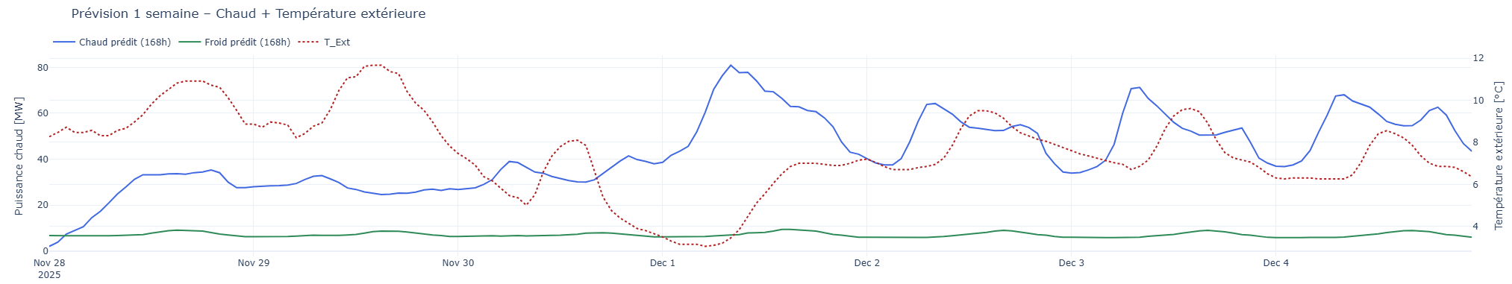
Addressing Operational Gaps & Next Steps
While accuracy is high, operational relevance requires addressing specific error patterns and building deployment-ready systems.
Current Operational Pain Points
A. Peak Accuracy Enhancements
Morning Bias: Morning under-prediction on very cold days remains our main gap, particularly between 06:00–10:00.
Add ΔT and longer memory (lag6, roll6h) and apply hour-specific bias correction.
D. Optional Model Gains & E. Toward Optimization
Explore Quantile HGB for P90 to mitigate under-prediction peaks.
Finally, export 168-hour forecasts to the dispatch tool and initiate a cost model stub to integrate forecasts into scheduling.
Lucie L. Mathéo I. Léo L.

